Slide 1
RediS
ASL
Russell Schlup

Slide 2
Usage
What is this for?
Redis is made for storing current data
Redis also uses mostly memory no disk writing
Why memory?
Memory is used because it is supposed to be used to store small bits of data for quick reviewing
What is this for?
This is mostly for Session data across all servers

Slide 3
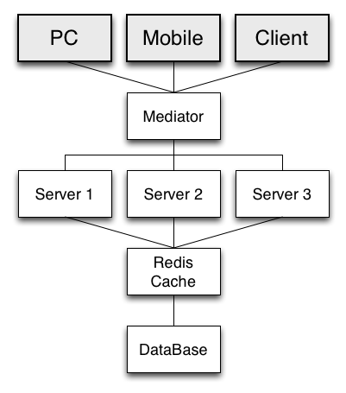
Redis Diagram
Redis visually explained

Slide 4
How to get it
Download
http://redis.io/download
Terminal
wget http://download.redis.io/releases/redis-2.8.7.tar.gz
tar xzf redis-2.8.7.tar.gz
cd redis-2.8.7
make

Slide 5
Use this thing
Run it from the src dir
src/redis-server
Now run the Redis terminal
src/redis-cli
Basic Commands
set msg “Hello World”
OK
get msg
“Hello World”

Slide 6
PHP
<?php
$db = new PredisClient(‘host=localhost:port’);
$sessHandler = new RedisSessionHandler($db);
session_set_save_handler(
array($sessHandler, ‘open’),
array($sessHandler, ‘read’),
array($sessHandler, ‘write’),
array($sessHandler, ‘destroy’),
array($sessHandler, ‘gc’)
);
session_start();
open – opens a connection
close – closes the connection
read – get stored data
write – stores data
destroy – blanks the session
gc – sets a

Slide 7
Python
import redis
db= redis.ConnectionPool(host='localhost', port=6379, db=0)
r = redis.Redis(connection_pool=db)
or
r = redis.StrictRedis(host='localhost', port=6379, db=0)
r.set(’msg', ’Hello World’)
True
r.get(‘msg’)
“Hello World”

Slide 8
Node JS
var redis = require("redis”);
var client = redis.createClient({host:’localhost’});
client.set(”msg", ”Hello World", redis.print);
OK
client.get(“msg”, function(err, reply){
//reply will be null if it’s missing
Console.log(reply)
})
“Hello World”

